Slide 1
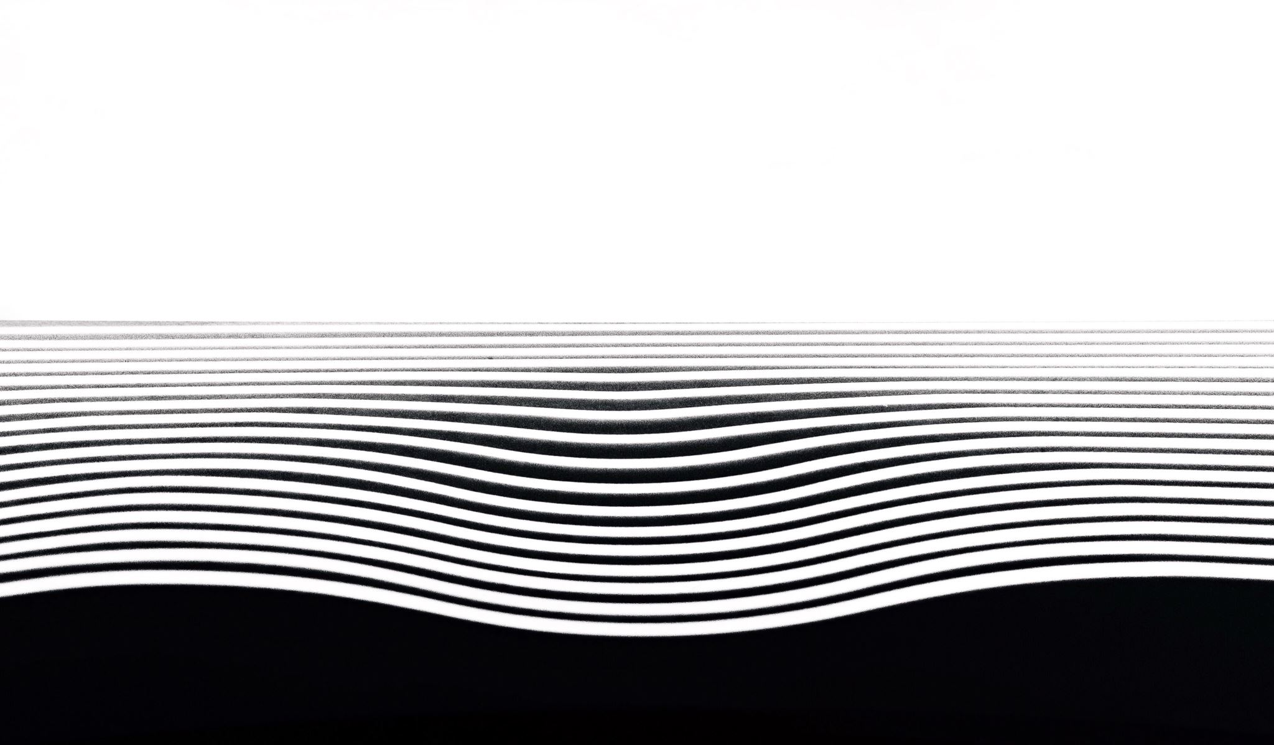
Shedding Some Light on the Light Up Puzzle with AI
James Browning, Robert Perera, and Libo Sun

Slide 2
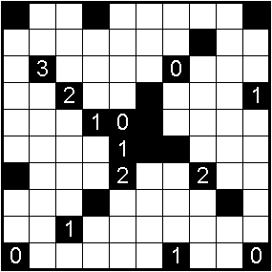
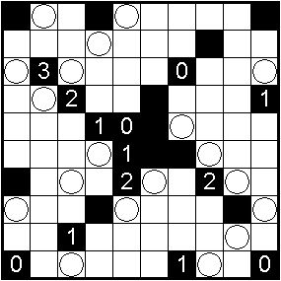
Recap: Problem Definition
The Light Up puzzle involves placing light bulbs into white squares to illuminate the entire board without any overlapping rays.
Black squares can’t be filled, and black squares with numbers inside them must have that number of adjacent bulbs.

Slide 3
Recap: Our Approach
To solve the oft-ignored Light Up puzzle with artificial intelligence, we planned a three-step approach.
First, randomly generate puzzles, then find optimal solutions using hill climbing.
Second, find optimal solutions using simulated annealing.
Third, use the data generated by the hill climbing and simulated annealing algorithms to train a deep neural network.

Slide 4
Our Progress
Since our midterm presentation, we have…
…completed initialization code for randomly generating Light Up puzzles.
…implemented hill climbing and simulated annealing for finding optimal solutions.
…successfully trained a convolutional neural network using the data generated by hill climbing and simulated annealing.

Slide 5
Results: Hill Climbing
The specifics of the hill climbing implementation, such as variables and success rate, will go here.
Anything left to do for this part of the project will go here.

Slide 6
Results: Simulated Annealing
The specifics of the simulated annealing implementation, such as variables and success rate, will go here.
Anything left to do for this part of the project will go here.

Slide 7
Results: Convolutional/Deep Neural Network
The specifics of the deep neural network implementation, such as training variables and success rate, will go here.
Anything left to do for this part of the project will go here.

Slide 8
Next Steps
While we are proud of the work we have done here, there is no doubt that more work (particularly, exploration of different algorithms) could yield even better results.
We strongly believe that the Light Up puzzle is an excellent logic puzzle for introducing newcomers to the field of AI to some of the more advanced algorithms available to them.

